Slide 1


Introduction to
Robotic Process Automation
music
Playlist
Suggestion
bot
Title of the Project
Register No:220701027
Name:Ansh Bhatia
Guide Name:mrs.jinu sophia
Designation and Department:assistant prof/CSE

Slide 2
Abstract
Music Playlist Suggestion Bot is an intelligent automation solution developed using UiPath to enhance user experience in music streaming or personal media libraries. This bot analyzes user preferences, including past listening habits, mood inputs, and genre preferences, to generate customized playlists. Leveraging UiPath's capabilities in data scraping, API integration, and decision-making workflows, the bot interacts with music platforms like Spotify, YouTube, or local databases to retrieve and organize songs. Key features include real-time user interaction, dynamic playlist updates, and the ability to integrate with external APIs for advanced recommendations using machine learning models. By automating the process of playlist creation, the bot reduces user effort and provides tailored music experiences with high accuracy and efficiency. This project demonstrates the potential of RPA in enhancing personalized entertainment services

Slide 3
Need for the Proposed System
The proposed Music Playlist Suggestion Bot using Robotic Process Automation (RPA) aims to automate and personalize the music recommendation process by collecting and analyzing user preferences to create tailored playlists. The system starts by gathering data on user habits, including preferred genres, artists, and mood, either through direct user interaction or by extracting information from music streaming platforms. Once the data is collected, RPA bots process the information to build a user profile and use it to search music databases for songs that match the user's tastes, creating a personalized playlist. The bot then delivers the playlist to the user and can automatically update it over time as user preferences evolve or new music trends emerge. Additionally, the system uses user feedback to refine the playlist suggestions, ensuring continuous improvement. The bot is scalable and can integrate with multiple music platforms, providing a seamless experience for users across different services. By automating the playlist creation process, the system reduces manual effort, enhances efficiency, and ensures that users receive up-to-date, personalized music recommendations, ultimately improving their overall music discovery experience.

Slide 4
Advantages of the Proposed System
1)By automating the user data collection,playlist creation and the suggestion processthe system eliminates manual intervention, saving time and effort for both users and developers.
2) Automating the playlist creation process reduces the need for human curators, lowering operational costs.
3) The bot can continuously update playlists based on evolving user preferences or the introduction of new music.
4) The system can handle large numbers of users simultaneously without compromising performance.

Slide 5
Literature Survey
Shardanand and Maes (1995) introduced collaborative filtering for recommending songs based on user preferences
Melchionna et al. (2017) highlighted the use of content-based methods in recommending music based on song attributes and user behavior.
In the context of Robotic Process Automation (RPA), Kovacs et al. (2021) discussed how RPA could be integrated into music recommendation systems to automate the playlist creation process
ADVANTAGES:
1.Efficiency and automation.
2.Accuracy in standardised tasks.
3.Playlists gets updated based on user prefrences
DISADVANTAGES:
1.Data integrity issues.
2.Security risks.
3. Limited Creativity

Slide 6
Main Objective
The main objective of the Music Playlist Suggestion Bot using Robotic Process Automation (RPA) is to automatically generate personalized music playlists based on the user's current mood, enhancing the overall music discovery experience. By leveraging mood-detection techniques, the bot aims to identify the user’s emotional state—whether happy, sad, relaxed, or energetic—through user input or interaction patterns. Once the mood is detected, the bot curates a playlist that matches the emotional tone, selecting songs based on factors such as tempo, genre, and lyrics. This process is automated through RPA, enabling real-time, mood-appropriate recommendations without the need for manual intervention.

Slide 7
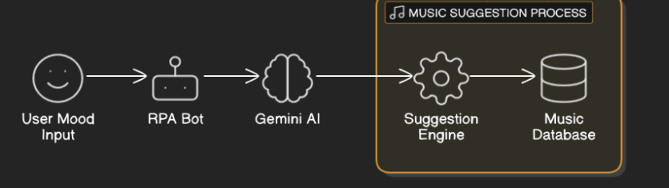
Architecture

Slide 8
System Requirements
Hardware
1.A device with uipath studio.
2.Network connection.
Software
1.uipath studio.

Slide 9
Functional Description
Capturing mood of user:
The Music Playlist Suggestion Bot using Robotic Process Automation (RPA) functions by first capturing the user’s mood through various input methods such as text, with the system. Upon detecting the user’s mood, whether happy, sad, relaxed, or energetic, the bot processes this information to determine the appropriate type of music that aligns with the emotional state.
Automates playlist based on user mood:
The RPA bots then automate the process of searching through music databases or streaming platforms to curate a playlist, considering factors like tempo, genre, and lyrics, which are linked to the identified mood. The playlist is then delivered to the user in real time, offering music recommendations that are tailored to enhance or complement their current emotional state.

Slide 10
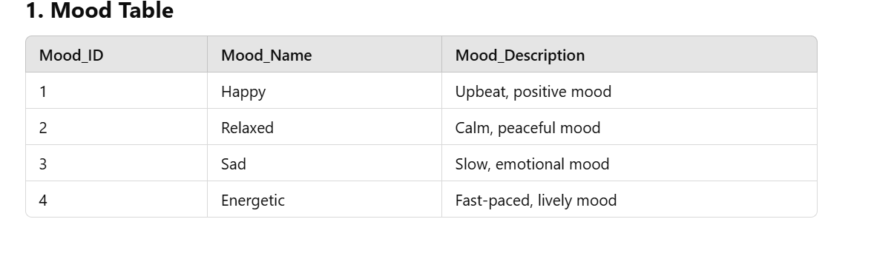
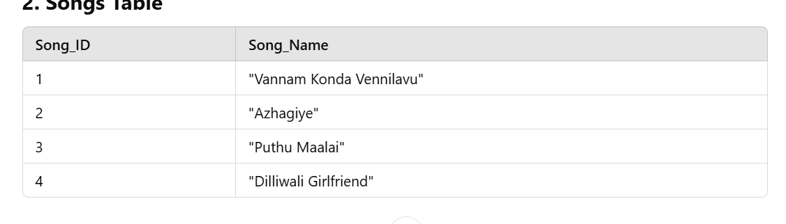
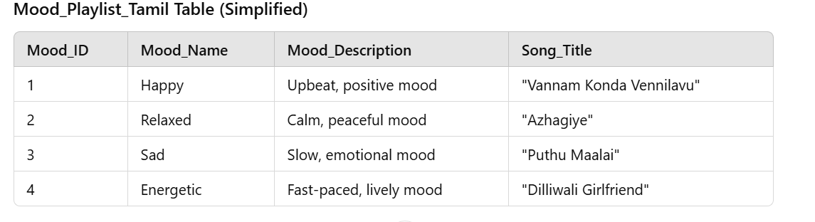
Table Design

Slide 11
Process Design
Main Process
The main process involves detecting the user's mood and then automatically suggesting a personalized music playlist based on that mood. The system first analyzes the user's input to detect their emotional state, such as happy, sad, relaxed, or energetic. Based on the identified mood, the bot then generates a playlist of songs that match the emotional tone and delivers it to the user.
Sub process
In this subprocess, the RPA bot interacts with Gemini AI to analyze the user's mood based on input, such as text or voice. Gemini AI processes the emotional state (e.g., happy, sad, energetic, relaxed) and generates a playlist tailored to that mood. The RPA bot then retrieves the playlist from Gemini AI through API calls or integrations Finally, a Message Box activity displays a success message, confirming the playlist is ready for listening. This automated process ensures real-time, mood-based music recommendations without manual intervention.
.

Slide 12
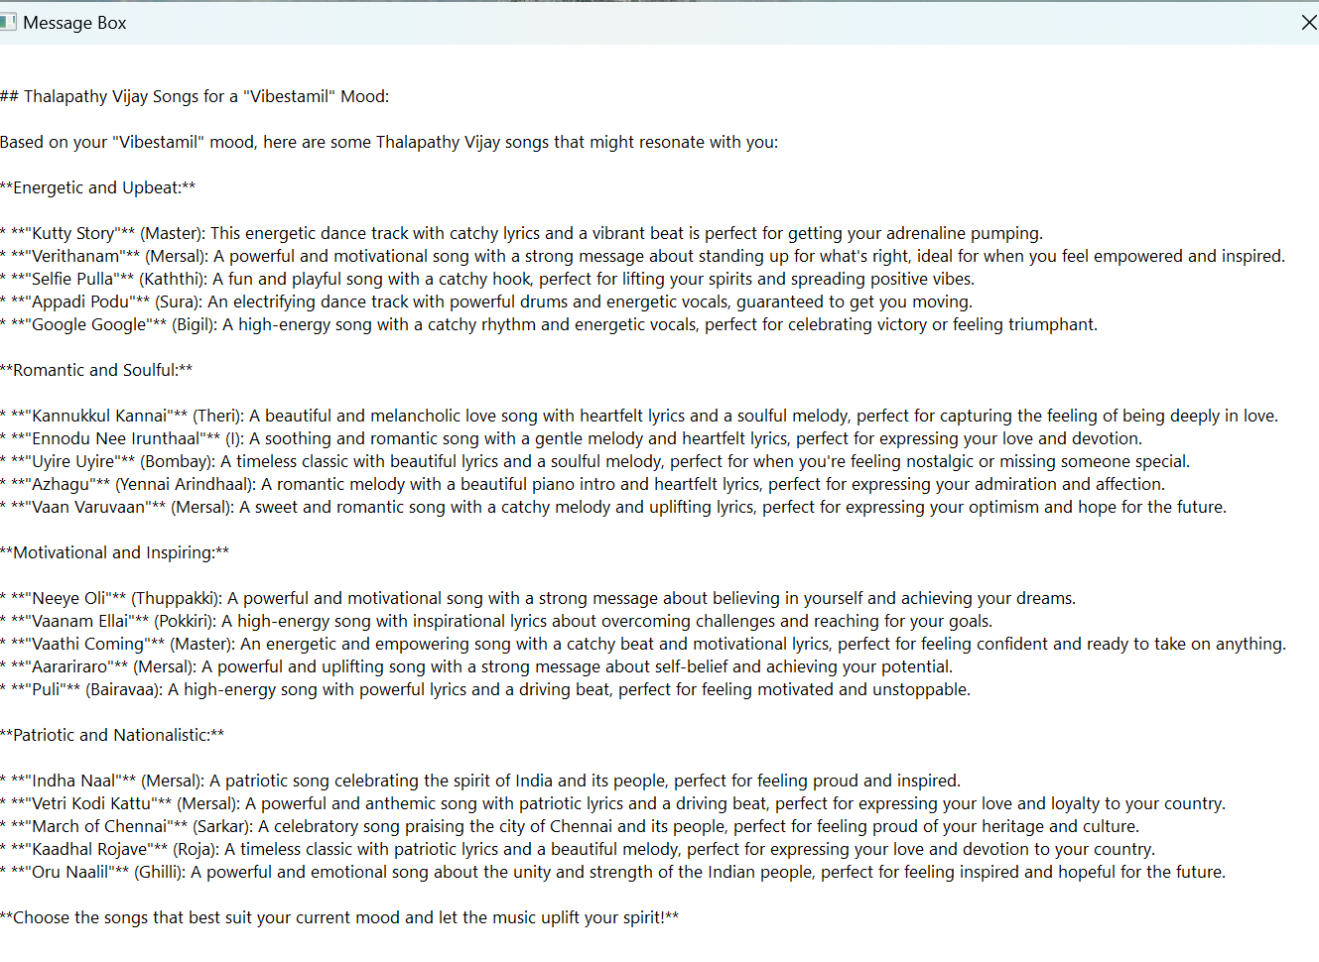
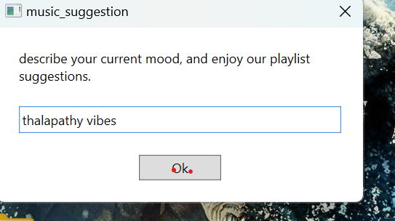
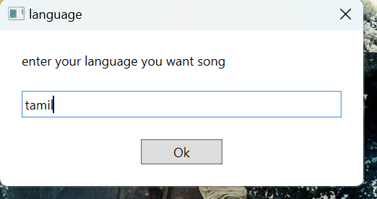
Testing

Slide 13
Conclusions
In conclusion, the Music Playlist Suggestion Bot using RPA that detects the user’s mood and generates personalized music recommendations represents a significant advancement in automating personalized user experiences. By leveraging RPA and mood-detection capabilities, this system provides users with dynamic, mood-based playlists that enhance their overall listening experience. The integration with AI tools like Gemini AI ensures accurate mood analysis, while the automation process streamlines the generation and delivery of tailored playlists in real time. This approach not only improves user engagement but also offers a scalable, efficient solution for music platforms to deliver personalized content.

Slide 14
Future Enhancement
Advanced Mood Detection: Use sentiment analysis from social media or wearables for better mood recognition.
Social Sharing: Allow users to share mood-based playlists with friends or create collabrative playlist.
Cross-Platform Support: Enable integration with multiple music streaming services for more music options.
Voice Command Integration: Allow users to interact with the bot using voice commands for a hands-free experience in mood-based music selection.

Slide 15
References
Kovacs, P., Sharma, A., & McDonald, A. (2021). Automating playlist generation using Robotic Process Automation (RPA) for personalized music experiences. International Journal of Automation and Computing, 18(1), 1-12. https://doi.org/10.1007/s11633-021-1289-2
2. Gómez, E., Celma, O., & Herrera, P. (2010). Music recommendation and discovery in the long tail. Proceedings of the 11th International Society for Music Information Retrieval Conference (ISMIR), 261-266.

Slide 16
Queries

Slide 17
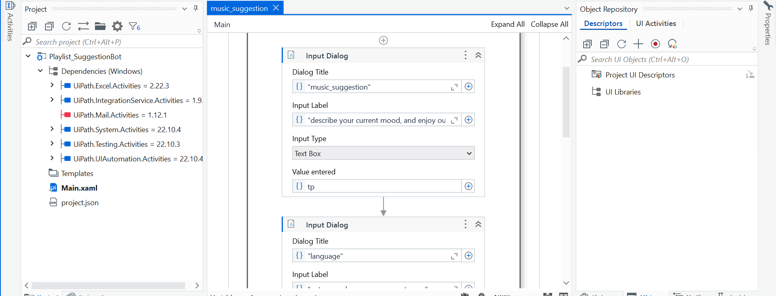
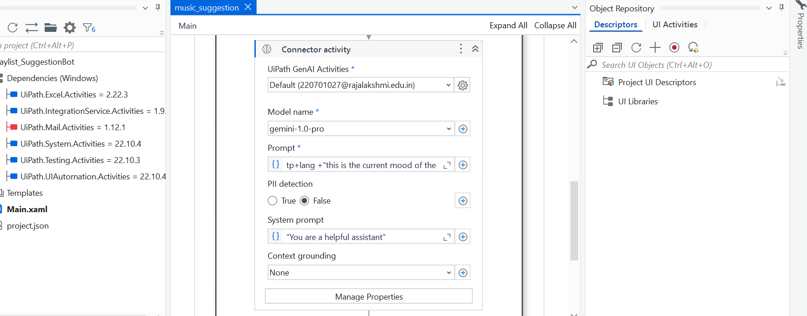
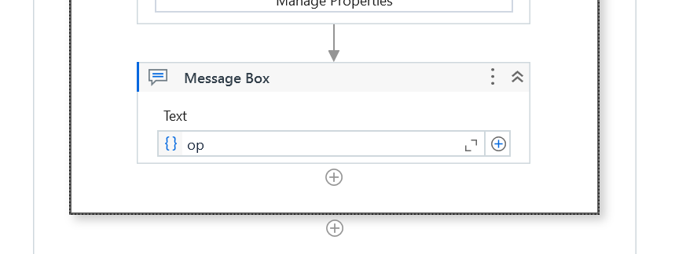

Slide 18
Thank You

